Slide 1
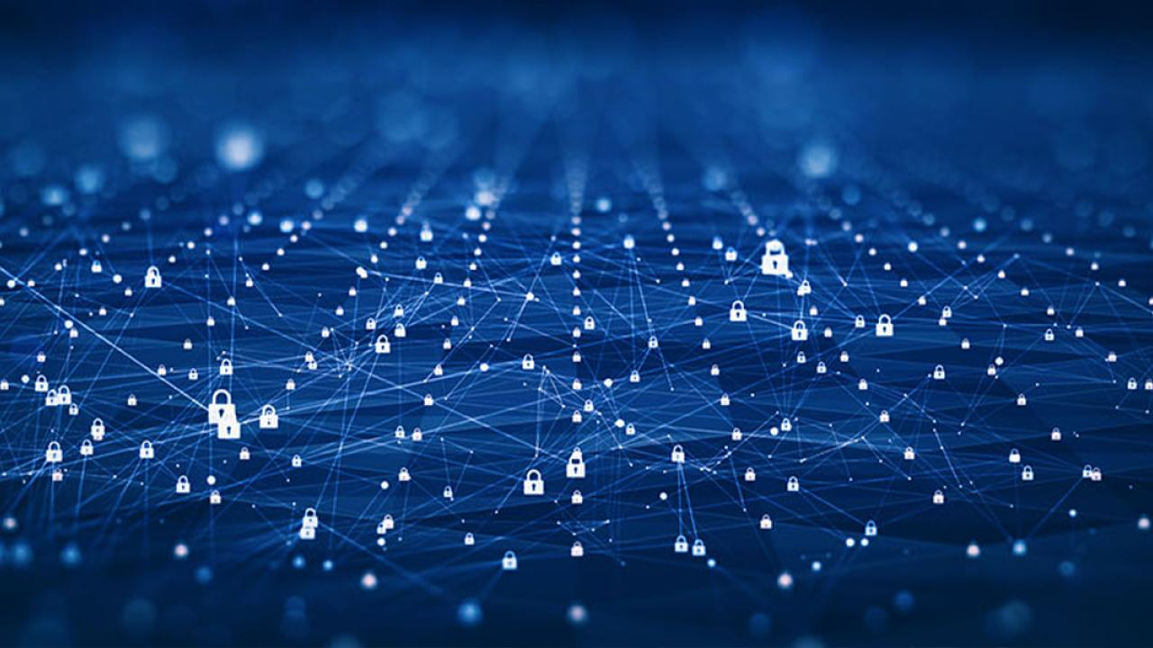
Keyspace Technology
From Assumed Trust to Assured Integrity

Slide 2
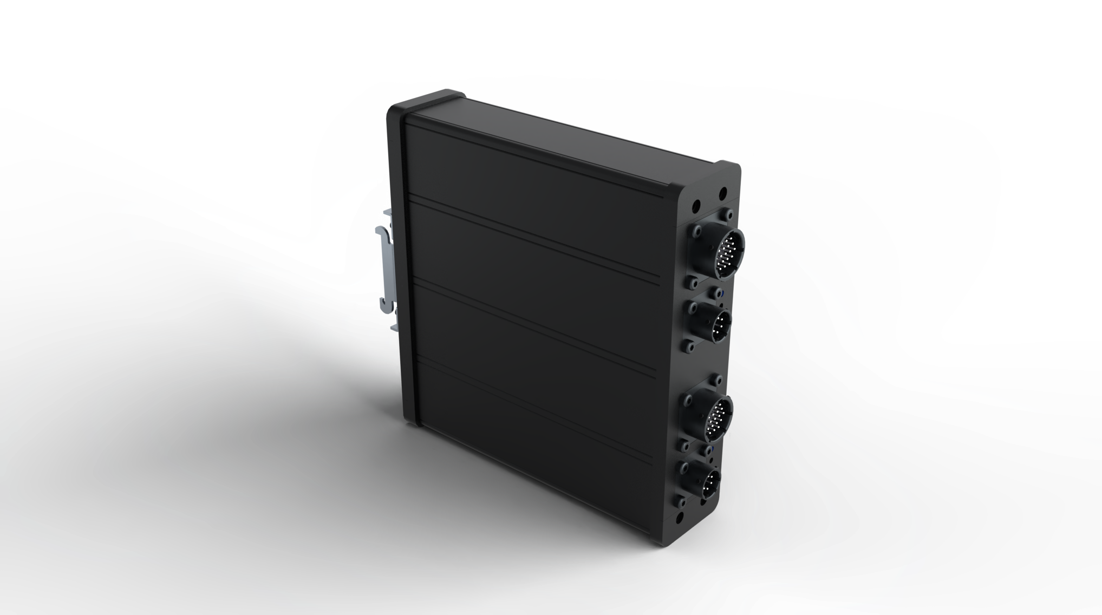
Bottom Line
Keyspace Technology (KST) renders any connected system immune to all known and unknown cyber attacks; including attacks mounted by AI and quantum computers.*
* YES, this is accurate and verified by third-parties.
Notes:
“…renders any connected system immune…” (connected = cyber-physical, IoT/IIoT, any system that must exchange data with other systems via open or even closed loop exchanges to effect action/change)
KST enforces deterministic validation at the execution boundary. That means that only structurally valid, cryptographically authenticated, and rule-conforming instructions can be acted upon. Commands that violate those constraints never reach the execution layer; whether by accident, insider threat, or attack.
In practical terms:
If a control signal is malformed, it’s dropped.
If it’s syntactically correct but contextually invalid, it’s dropped.
If it’s a replay, injection, or timing attack, it’s dropped.
All of which happens before any system has the chance to act. So, KST doesn't respond to compromise, it prevents consequence.
“…to all known and unknown cyber attacks…”
Known attacks rely on signature, pattern, or behavioral recognition. Unknown attacks (zero-days, novel techniques, APT pivoting) bypass those by looking like legitimate traffic. KST doesn’t care about signatures or history.
It enforces hard boundaries:
Structure
Timing
Cryptographic identity
Command logic
Signal integrity
That means even if the attacker’s method is novel, if the signal doesn’t meet KST’s enforcement rules, it doesn’t get through.
“…including those mounted by AI`…”
AI-generated attacks tend to mimic legitimate behavior, operate faster than human analysts, chain subtle moves across attack surfaces and target inference gaps in detection logic, but KST isn’t behavioral. It’s structural.
No matter how well AI mimics user behavior or system syntax, it can’t fake:
Protocol-level constraints
Timing integrity
Hardware-authenticated identity
Deterministic rule conformance
AI doesn’t get special treatment. KST doesn’t negotiate.
“…and quantum computers.”
Quantum attacks threaten cryptographic systems that rely on several well known and limited life functions.
Factorization (RSA)
Elliptic curves (ECC)
Discrete log problems (DH)
KST uses non-factorization-based crypto primitives for signal validation (e.g., symmetric key MACs, one-time pads). It operates without reliance on key exchange or PKI infrastructure and enforces integrity at the control boundary, not just in-transit encryption. This means that even if an adversary broke upstream cryptography with a quantum computer, they still couldn’t issue a valid command that KST would accept, because the enforcement happens outside the cryptographic domain: at the execution constraint level. It also limits all the massive effort (even for quantum-systems) on understanding an attack that had relevance for a few milliseconds. At which point KST has changed the key and moved on.

Slide 3
Problem
Every connected system acts on communications that cannot be proven as trustworthy.
Beneath the human information layer (where conventional cyber operates) trust is assumed and cannot be verified.
The trust we place in our modern tools is not earned, it is given.
Notes:
Strategic Crisis:
The modern world exists in two halves; the human-centric and machine signals/data.
For more than 40 years we have focused on the security of human-generated information. So much so that the risk of machine-generated data loss and manipulation have been significantly downplayed, ignored or left unseen for most of that time. To compensate, machine-generated information was largely air-gapped to provide integrity, but this model is no longer possible to maintain.
Policy leaders have a lot to catch up on, quickly.
Infrastructure systems are the softest they’ve ever been; adversaries know it
China’s 2027 timeline heightens urgency
Probabilistic cyber defenses are unable to meet deterministic requirements.
A single spoofed command can trigger cascading national consequences
‘We’re essentially bailing water out of a sinking boat without patching the leak.’ (Verizon PSR 2022)
The 2027 horizon is not theoretical. Our adversaries have published timelines for achieving military and cyber readiness. OT systems are softer than they’ve ever been. A single spoofed command could create cascading national effects and destabilize national security and confidence in its leaders.

Slide 4
Problem – Market Synopsis
We lack a practical, provable method to ensure the integrity of machine-to-machine (M2M) communications, particularly in real-time systems.
KST addresses a problem we have been trying to solve for over a decade now. And I don’t just mean our agency, I mean “we” the ENTIRE PLANET.
U.S. government official with direct responsibility for the cyber defense of ~$800B in mission-critical assets (October 2025)
“
”
The problem is real and we have no solution.
Notes:
After decades and trillions spent globally, we still don’t know:
“Was the command modified?”
“Did it come from the right authority?”
“Did the system act appropriately or did something fail?”
Most people understand information risks, but far fewer understand operational risks. We often refer to the systems Information Technologies (IT) and Operational Technologies (OT)
IT is about information, human-generated and centric. Everything from emails, to reports, databases and calendars. Threats here last for decades. A loss of your SSN, could present challenges for the rest of your life, but they typically won’t kill you.
OT is about machine-generated communications between devices that can have very real physical outcomes. Commands negotiate exchanges between computers, move steel, spin turbines, open breakers, steer ships. The attack surface is milliseconds. When OT is compromised, the losses are immediately tangible and often kinetic, things break, systems stop working and that can place lives at risk.
Until recently that smaller window of time afforded some protections to OT, but that isn’t true anymore.

Slide 5
Impact
Assumed trust exists in every sector, meaning unverifiable machine communication drives ALL real-world activity.
Whoever can fake machine instructions can control the modern world.
Notes:
Every sector runs real-time M2M operations on unverifiable inputs.
Falsified M2M commands trigger instant physical consequences.
Scale makes it worse; more M2M automation = more unverified actions.
No operator can prove M2M integrity before machines act.
Examples
Power Generation & Distribution: Real-world actuation from unverifiable digital inputs—blackouts, surges, and manipulation risks.
Autonomous Vehicles: Motion and coordination triggered by machine-to-machine commands with no guaranteed integrity.
Advanced Manufacturing / Robotics: Line-speed automation accepts upstream logic blindly—no enforcement at signal boundaries.
Defense Systems / Weapon Coordination : Targeting, movement, and kill chain logic depend on trust in timing and signal origin.
Water Treatment & Distribution: Critical chemical processes are exposed to malformed or replayed control inputs—see Oldsmar.
Food & Pharmaceutical Safety Systems : Environmental and batch controls are operated via unauthenticated, protocol-tolerant networks.
Telecommunications Infrastructure: Signal control and routing logic rely on “safe by configuration” assumptions—easily subverted.
Transportation Systems (Rail, Maritime, Aviation): Control instructions often transit unsecured internal buses or exposed field networks.
Information Technology Automation: CI/CD pipelines, orchestration engines, and endpoint triggers execute on the basis of assumed-valid input—no enforced boundary.
If you’re leveraging:
AI
Infrastructure automation
Connected health
Industrial autonomy
Model-driven finance
Space systems
Smart legal platforms
Then you are betting that the instructions driving those systems are authentic, safe, and bounded, they are not, and your portfolio is a gamble on assumed trust. KST is the mechanism that protects your investment.

Slide 6
Failure of Current Approach
The problem exists because machine communications move too quickly and in the wrong place for conventional cyber to verify and authenticate, ever.
Detection can’t prevent a disaster after the fact.
Notes:
Probabilistic defense = predominantly software, most deployed cyber security technologies today.
Deterministic defense = predominantly hardware
Conventional cyber tools detect, alert, log, and notify. None of them can authenticate a command before execution. Zero-days bypass detection entirely. Human operators make predictable mistakes. Existing approaches are inadequate. There is an unavoidable need for deterministic hardware-enforced authenticity.
To compound the issue, the wrong solutions are being sold to customers by incumbents not able or inclined to solve the problem.
Software sits on CPUs and attackers can bend both.
Detection tools react after the machine has already acted.
Zero Trust assumes safe inputs; attackers fake those inputs.
Zero-Day attacks walk past monitoring systems.
“Sanitize in software” fails because the sanitizer itself can be exploited.
Hardware features inside CPUs remain configurable by compromised software.
Humans are still required to act – before and after events – making them the largest point of failure
This is perpetuated because there is a common believe that “no tool can prove a command is authentic before execution.” Detect and analyze all you want after, but no one puts the seat belt on during the impact.

Slide 7
Consequences of Inaction
One bad command can bring it down.
Left unresolved, loss of control is inevitable.
When it happens, leaders will answer for why their systems acted on lies that they now know to be preventable.
Legal, political and historical liability is unbound.
Notes:
Integrity failures become inevitable as systems scale.
One bad signal can halt operations, damage equipment, or trigger outages.
Stakeholders lose confidence in automation and remote operations.
Adversaries exploit structural weaknesses the organization never closed.
Leadership faces scrutiny for leaving authenticity unenforced at the boundary when a solution exists.

Slide 8
Solution
The only way to stop this is to enforce trust at the machine boundary.*
To prevent loss, we must challenge everything at the lowest level, not the highest.
Notes:
Deterministic defense solutions:
Operate independently from Probabilistic defenses (IT, human-generated data).
Cannot be bypassed.
Minimal attack surface.
Authenticity before action.
Immune to software compromise.
Validate each command in real-time OR function in real-time outside of the command pathway (e.g., mechanical interlocks)
* https://www.gartner.com/en/newsroom/press-releases/2025-09-18-gartner-says-that-in-the-age-of-genai-preemptive-capabilities-not-detection-and-response-are-the-future-of-cybersecurity, which focuses on other potentials… that still fail, but the sentiment is correct, just misplaced.

Slide 9
Solution – Keyspace Technology (KST)
KST is the first system to demonstrate practical, scalable, real-time provable trust at the boundary.
Loss can now be limited, even eliminated.
Notes:
Enforces authenticity using deterministic hardware logic; before action.
Operates independent from probabilistic defenses; below the software stack.
Employs Quantum Resistant (PQC) encryption in a One-Time-Pad model to provide tamper-proof integrity
Validates each signal in real-time; denies anything not genuine.
Immune to software compromise; it does not use software.
Drops in-line with zero network changes; works across any network or protocol and topology.

Slide 10
Solution – KST
KST ensures that no signal enters any protected system unless it is structurally valid, behaviorally correct, and cryptographically verifiable.
Only the actions you expect can happen.
Notes:
Unlike software tools, KST provides protection even if the environment is already compromised. Even after an attacker gains access to an unprotected system, KST would refuse to allow altered or malicious commands.
This shifts the entire defensive model: we no longer need to pursue perfection at keeping attackers out (not achievable)—we only need to ensure they cannot misuse control systems once inside.

Slide 11
KST – Benefits
Demonstrated operational benefits, not theoretical.
Secures M2M at the machine boundary
24/7 autonomous proactive protection
20+ year lifespan
Real-time operation
No software, No patching, No maintenance, No key management - No human in the loop
No change to existing network required
Stops known and unknown attacks
Secures compromised systems
Extends life of legacy installations
Strengthens conventional cyber
Easy Installation
“U.S. Navy Testing Demonstrates Keyspace Technology Performance” (December 2025)
Notes:
https://blueskytec.us/news/u-s-navy-testing-demonstrates-keyspace-technology-performance/

Slide 12
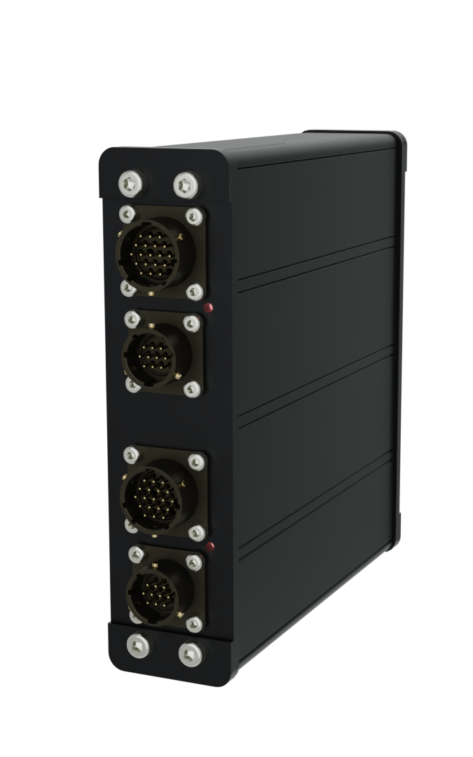
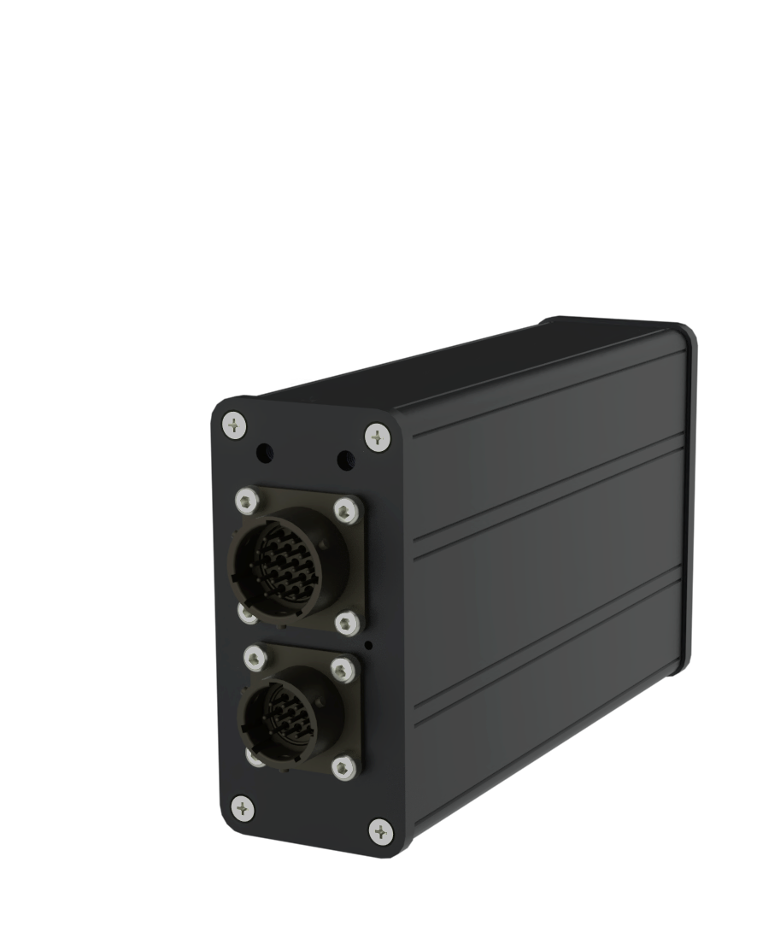
KST – Differentiation
Port 1: [RED / Plaintext] from Edge Device
Port 2: [BLACK / Ciphertext] across Network / Signal Path
End-to-end FPGA logic enforced
Quantum Computer & AI Resistant
  One-Time-Pad / One-Time-Key Model
  NIST certified DRNG + QRNG Key Material
  Zero-Trust Tenants in Logic
  Algorithms in Logic
  Packet-level Authentication and Validation
Policy Enforcement at Edge (Compliance)
Dual Data Diodes, NGFW, IDS
Patented Anti-Tamper Features
Protocol and Signal Agnostic
S100-102 Edge Protector
Rugged Cu-Cu Ethernet
S100-202 Edge Protector
Rugged Cu-Cu Ethernet Physically Redundant
Notes:
Most cybersecurity tries to detect and respond faster. KST removes entire classes of attacks altogether. Quantum computing breaks encryption based on math. AI breaks defenses based on patterns. KST avoids both by enforcing trust physically and deterministically.
One-time pad security with pre-placed quantum entropy: KST uses true one-time pad encryption seeded before deployment. There are no keys to steal, intercept, or compute. Quantum computers offer no advantage against it.
No dependence on “hard math” assumptions: Most security bets that problems stay computationally hard. KST does not. It avoids RSA, ECC, and post-quantum algorithms entirely by design.
No session setup or negotiation: There is no handshake, exchange, or trust establishment to observe or manipulate. This removes the attack surface AI and advanced adversaries rely on.
Keys exist only in hardware, never as software: Critical key material never runs as code and never enters system memory. AI cannot inspect it. Malware cannot extract it.
Deterministic enforcement before execution: Every packet must be correct before it is allowed to act. There is no learning curve for the attacker and no tolerance for “almost right.”
Validation at the physical and protocol layers: KST enforces correct electrical behavior, timing, framing, and protocol use. Attacks are stopped before traditional cyber tools even apply.
Device identity bound to physical presence: Trust is tied to the hardware itself, not credentials that can be copied or replayed. Impersonation and digital twins fail.
Invisible to scanning and reconnaissance: No IP address, no MAC address, no response to probes. AI reconnaissance sees nothing to model.
Security logic cannot be modified in the field: Core protections are fixed at manufacture. Adversaries cannot adapt the system to themselves over time.
Operates independently of cloud or external services: Protection remains intact even when disconnected. There is no external dependency to poison or exploit.
Each KST Protector has:
2⁶⁴ keys per domain (enough for nearly 70k years of aggressive Industrial Control System conversations) and each Protector contains up to 128 domains per device (based on current storage technology). Total keys per device = 2⁶⁴ × 2⁷ = 2⁷¹.
Data Diode = One-way data gate. Information can leave, nothing can come back.
NGFW (Next Generation Firewall) = Smart traffic guard. Allows good activity, blocks known and suspicious behavior.
IDS (Intrusion Detection System) = Security alarm. Watches for attacks and raises alerts.
AI adversaries have changed the battlefield. Automated tools can generate thousands of spoofed commands per second. Software cannot keep up. Deterministic hardware can. This slide positions KST as the only viable countermeasure to machine-speed, AI-enabled cyber threats targeting OT systems.

Slide 13
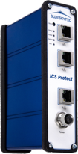
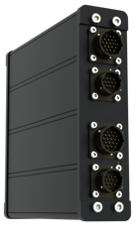


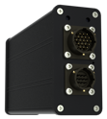
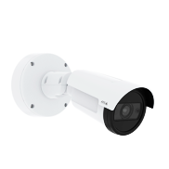
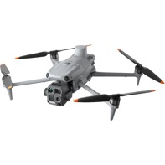
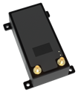
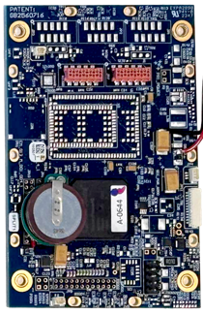
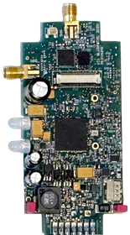

KST – Single Architecture, Multiple Applications
Redundant Rugged
Protector
(IP / Serial)
Std. Duty
Protector
(IP / Serial)
Rugged
Protector
(IP / Serial)
Tracking, Health & Usage Monitoring ”THUMs” Protector
(IP, Serial, NTN, 3G/4G/5G, CANBUS)
Embedded
Protector
(Serial, ISA95 Level 0)
Management
(In Band / Out of Band)
M12m
112mm x 73mm
68g / 2.40oz
100ma
Quantum Core Capable
M12t
93mm x 45mm
38g / 1.40oz
40ma
M12p
29mm x 21mm
3g / 0.11oz
<1ma
Capabilities & Performance
Trust & Integrity
Circuit board dimensions shown do not represent final product dimensions. Customer requirements can impact final IC design, non-critical features and enclosure selections.
Configuration subject to change, not to scale
Notes:
Hardware Root-of-Trust
Security Features 100% in Logic
Zero-trust protection (OSI Layers 1–4)
Packet-level Authentication
Symmetric One-Time-Key/One-Time-Pad
Cryptographically Sound PQC design*
Completely Rejects Unauthorized or Malformed Packets*
Ultra Low Latency (<0.5ms @1518 bytes)
Government-led evaluation complete

Slide 14
KST – Connection Model
P1
P2
P2
P1
Notes:
*RED/BLACK is a marker of traditional cryptographic function, not of network architecture.

Slide 15
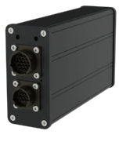


KST – Integrity Construct
Plaintext commands are sent over tamper-monitored connection
Commands are encapsulated, modified and encrypted with unique key from OTP; key index is advanced
Commands traverse networks using existing topology, cryptographically isolated from other “internet” traffic
Ciphertext commands are extracted from common traffic, authenticated and decoded; key index is updated, key is destroyed
Plaintext commands are received over tamper-monitored connection
INGRESS
S100-102 Edge Protector
Rugged Cu-Cu Ethernet
Edge Device
P1
Quantum-Resistant
Encryption
P2
P2
EGRESS
P1
Edge Device
S100-102 Edge Protector
Rugged Cu-Cu Ethernet
Notes:
KST operates at the signal level below software to authenticate each command exchanged between any two or more devices simultaneously – in real time.
Advanced Anti-Tamper, Quantum-Resistant Symmetric Pre-Placed Keys, Data Diodes (Ingress and Egress), Intrusion Detection, Next Generation Firewall

Slide 16
Thank you
Clinton Groves
CEO
cgroves@blueskytec.us
+1 (980) 281-0664

